Slide 1
Retrieval Augmented Generation

Slide 2
Agenda
Structural Diagram of a Standard RAG
Building Blocks Explanation
Different types of RAG
Corrective RAG
Fusion RAG
Speculative RAG
Agentic RAG

Slide 3
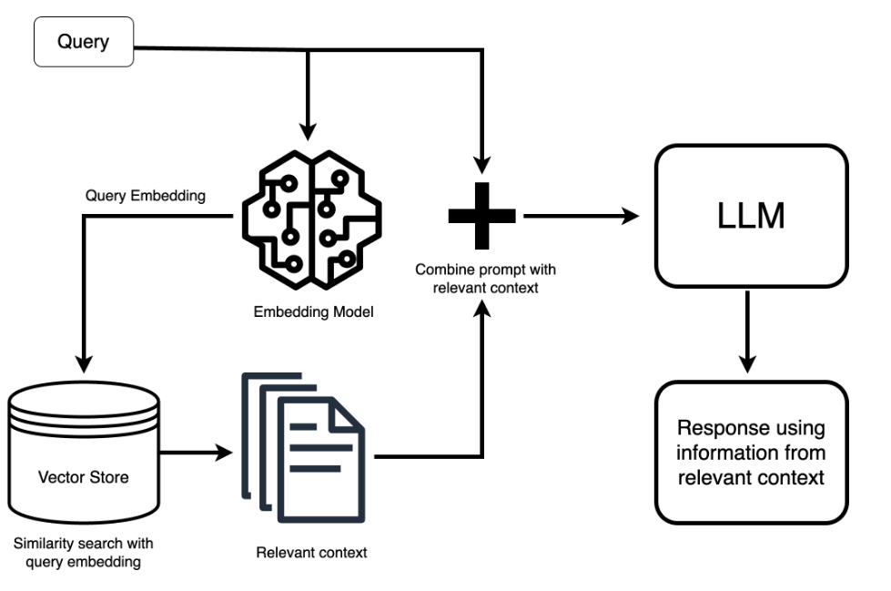
Structural representation

Slide 4
Explanation of each block
Querying: When you want to ask an LLM a question it may not have the answer to, you start by giving it a prompt, such as “What’s the latest development in AI legislation?”
Retrieval: This prompt goes through an embedding model and transforms into a vector itself—it's like it’s getting its own search terms based on its meaning and not just identical matches to its keywords. The system then uses this search term to scour the vector database for the most relevant chunks related to your question.
Prepending the Context: The most relevant chunks are then served up as context. It’s similar to handing over reference material before asking your question, except we give the LLM a directive: “Using this information, answer the following question.” While the prompt to the LLM gets extended with a lot of this background information, you as a user don’t see any of this. The complexity is handled behind the scenes.
Answer Generation: Finally, equipped with this newfound information, the LLM generates a response that ties in the data it’s just retrieved, answering your question in a way that feels like it knew the answer all along.

Slide 5
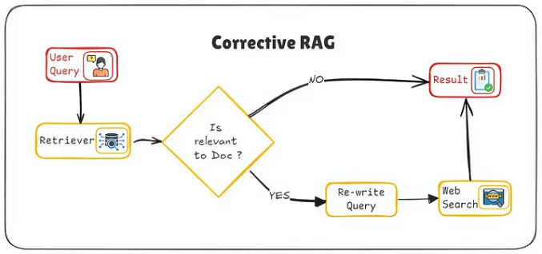
Corrective rag
Corrective RAG builds upon Standard RAG by meticulously refining outputs through error detection and correction, targeting applications where precision is critical, such as legal, medical, or technical domains. It employs multiple review cycles, leveraging user feedback to enhance response accuracy continually, ensuring a personalized and precise user experience. This method contrasts with Speculative RAG, which balances speed and accuracy for rapid response generation.

Slide 6
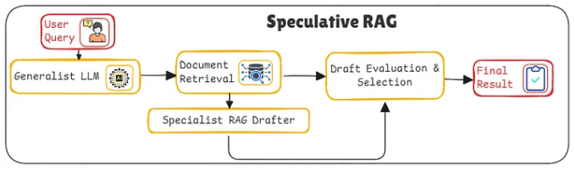
Speculative rag
Speculative RAG employs a dual-model system, combining a specialized model for rapid drafting and a generalist model for thorough verification. This setup enhances both speed and accuracy by processing multiple drafts simultaneously. It excels in scenarios demanding quick and precise outputs, such as content generation and real-time decision-making, by distributing complex tasks to specialized models, thereby optimizing response times and accuracy.

Slide 7
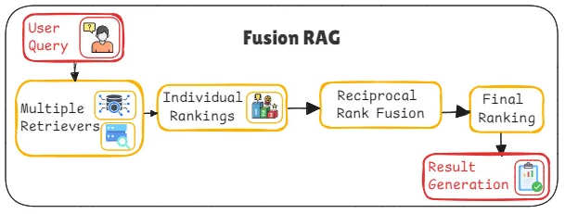
Fusion rag
Fusion RAG integrates multiple retrieval methods and data sources, enhancing response richness and comprehensiveness. It dynamically adjusts retrieval strategies based on query context, pulling from databases, documents, and real-time feeds. This diversity ensures resilient, well-rounded answers, making Fusion RAG ideal for complex question-answering systems or expansive knowledge bases that require multifaceted insights.

Slide 8
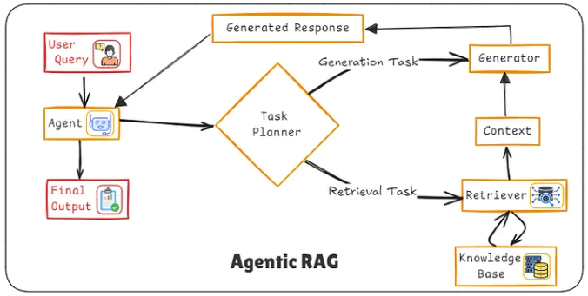
Agentic rag
Agentic RAG features adaptive agents that adjust retrieval strategies in real-time, enhancing response relevance and accuracy. Its modular design allows easy integration of new data sources and features, supporting continuous improvement and scalability. Ideal for applications requiring complex problem-solving and adaptability, such as intelligent virtual assistants and dynamic recommendation systems, Agentic RAG thrives in environments demanding rapid adaptation and sophisticated, evolving responses.

